Slide 1

WIPRO – Java Training
M.Ashok
Rajalakshmi Institutions

Slide 2
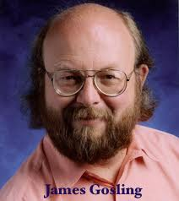
Java
programming language and a platform
Sun Microsystems (which is now the subsidiary of Oracle) in the year 1995
James Gosling is known as the father of Java

Slide 3
Applications
Desktop Applications such as acrobat reader, media player, antivirus, etc.
Web Applications such as irctc.co.in etc.
Enterprise Applications such as banking applications.
Mobile
Embedded System
Smart Card
Robotics
Games

Slide 4
Java Version History
JDK Alpha and Beta (1995)
JDK 1.0 (23rd Jan 1996)
JDK 1.1 (19th Feb 1997)
J2SE 1.2 (8th Dec 1998)
J2SE 1.3 (8th May 2000)
J2SE 1.4 (6th Feb 2002)
J2SE 5.0 (30th Sep 2004)
Java SE 6 (11th Dec 2006)
Java SE 7 (28th July 2011)
Java SE 8 (18th Mar 2014)
Java SE 9 (21st Sep 2017)
Java SE 10 (20th Mar 2018

Slide 5
Features of Java
Simple
Object-Oriented
Portable
Platform independent
Secured
Robust
Architecture neutral
Interpreted
High Performance
Multithreaded
Distributed
Dynamic

Slide 6
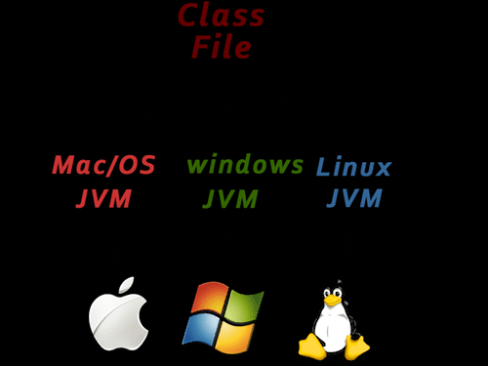
Platform Independent

Slide 7
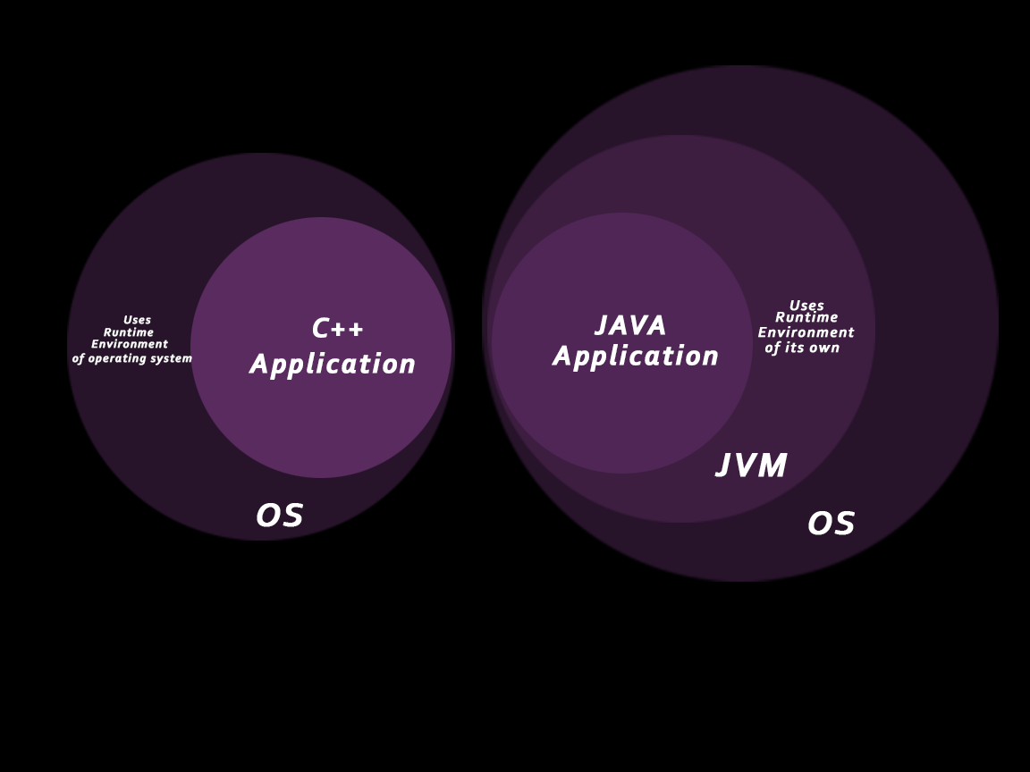
Secured

Slide 8
First Program
class Simple{
public static void main(String args[]){
System.out.println(“RIT");
}
}

Slide 9
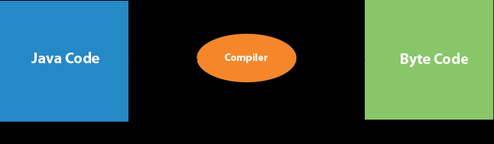
What happens at compile time?

Slide 10
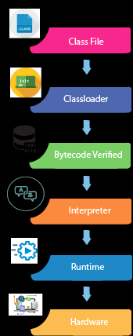
What happens at runtime?

Slide 11
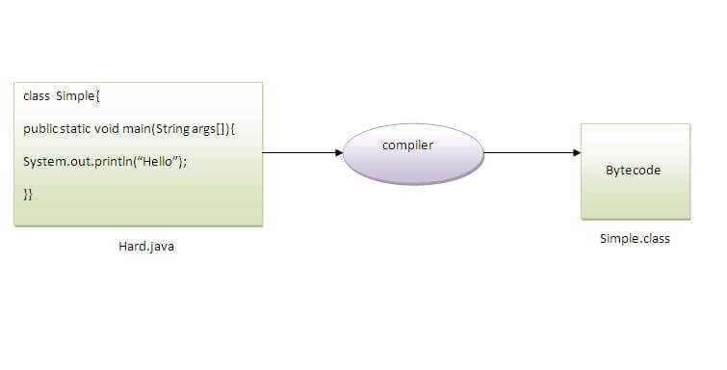
Naming Convention

Slide 12
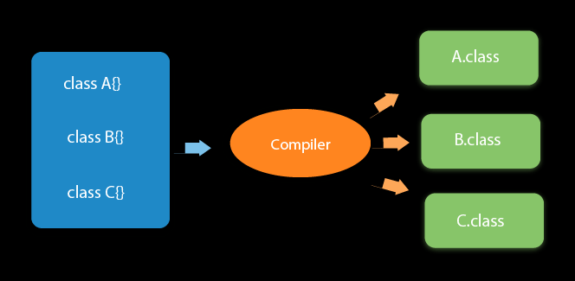
Multiple classes in a java source file

Slide 13
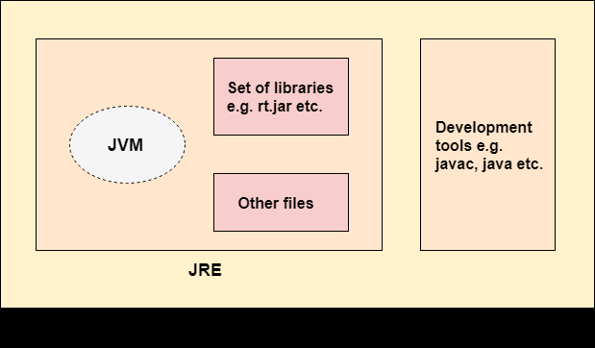
JDK, JRE, and JVM

Slide 14
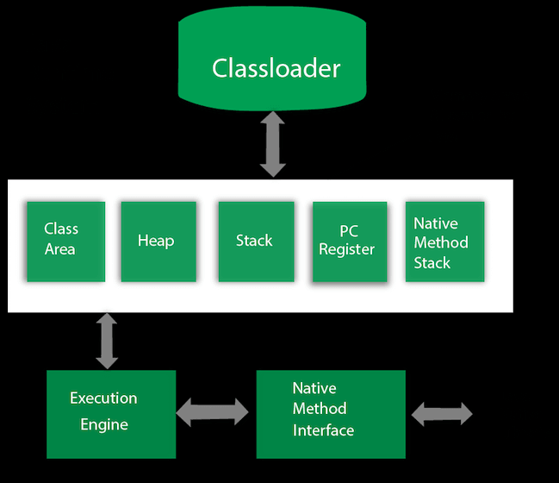
JVM Architecture

Slide 15
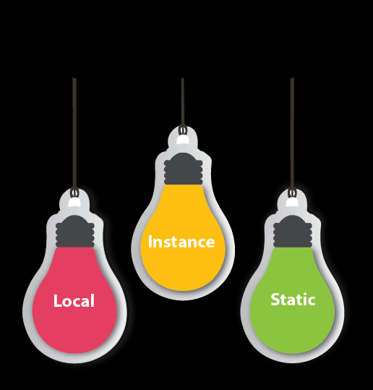
Variables

Slide 16
Program-1
class Simple{
public static void main(String[] args){
int a=10;
int b=10;
int c=a+b;
System.out.println(c);
}}

Slide 17
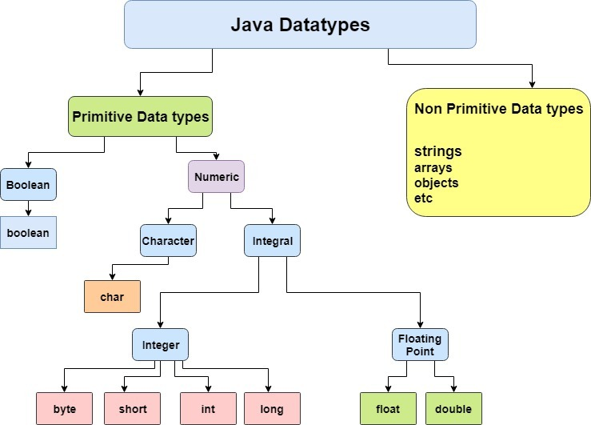
Datatype

Slide 18
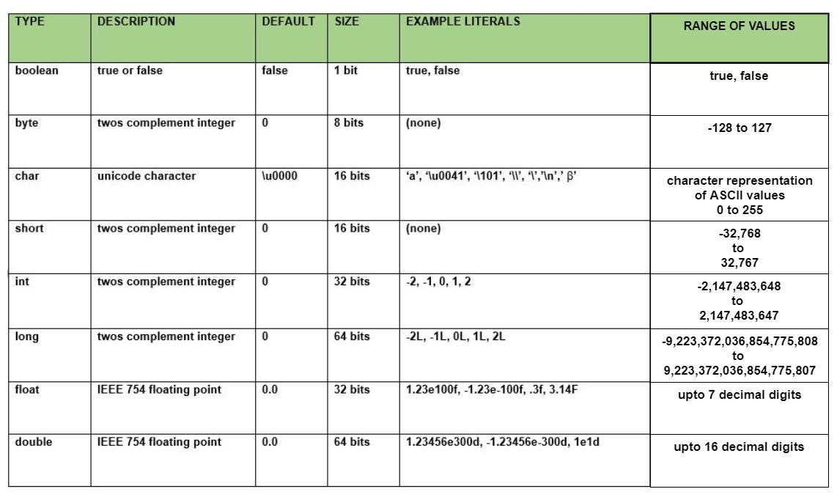
Default Values

Slide 19
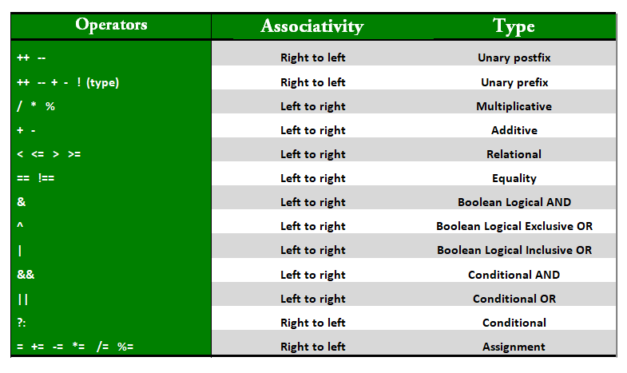
Operators

Slide 20
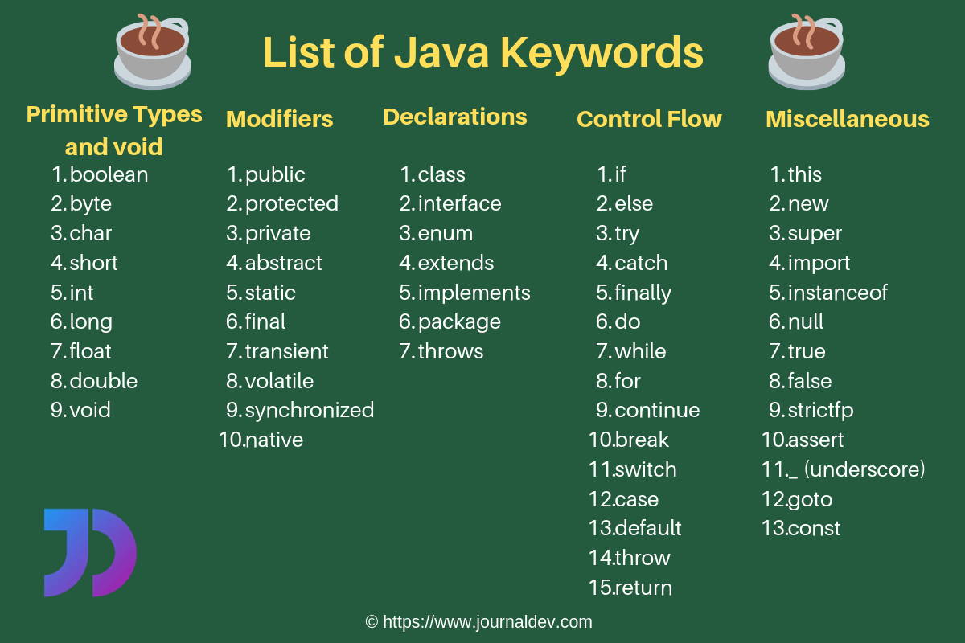
Keywords

Slide 21
Quiz Time
joinmyquiz.com

